Slide 1
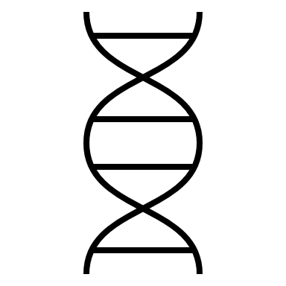
The Role of TRAs in Early Embryonic Development
Final project presentation
Group 4: Amena Elmaadawy, Mariam Hassan, Nina Droste, Aleksandra Dohren
Supervisors: Dr. Maria Dinkelacker, Ian Fichtner
Molecular Biotechnology B. Sc, Ruprecht Karls University of Heidelberg

Slide 2
Large changes in gene expression between four- and eight-cell stages are linked to the expression of TRAs and thus to tissue development
Notes:
True, 4-8 cell stage ist overregulated: DGE, unsignifikant unsignifikant sagt niht, dass es keine changes gibt.
Tissue development: Wir haben getestet GSEA 4/8/ all show HYPOXIA Pathways, and no tissue development pathways
There larges change in gene exressioen do not indicate tissue development. Therefore TRA expression is not mecessarly liked to tissue development

Slide 3

Sub questions
Is the greatest TRA expression found between the fourth and eighth cell stage?
Is gene expression in bovine comparable to the expression in mouse?
What is an important biological function expressed by those genes?
Notes:
Yes, we found that with DGE -> Graphen tabellen etc.
We dont have bovine TRA data sets to match but we compared pathways that are significant in either bovine or mouse and we didnt find matching ones. With given tra table bovine we are able to identify TRA Genes that are behaving similarly in both, mouse and bovine. More time and resou
We found pathways -> Hypoxia

Slide 4
Recap

Slide 5

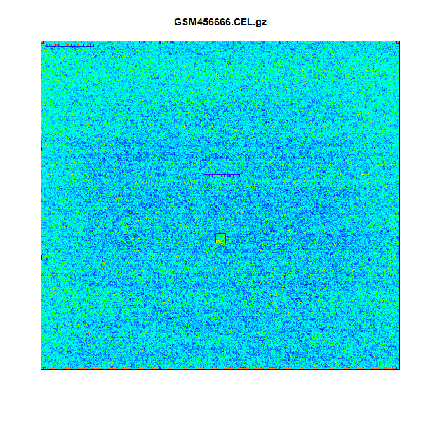
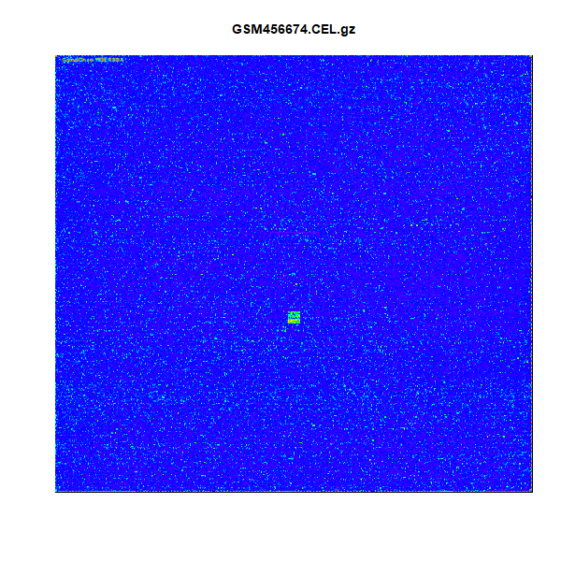
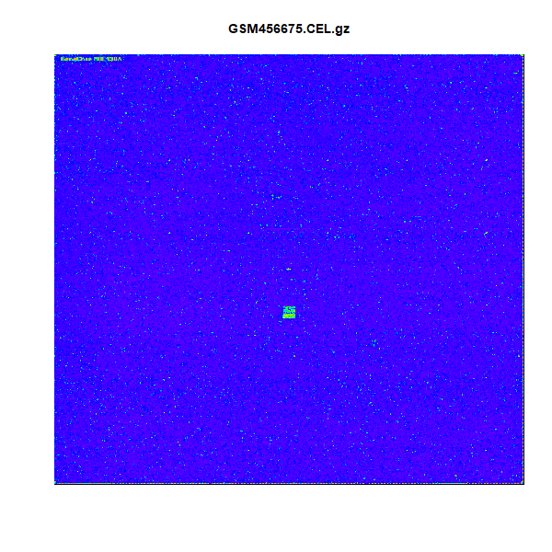
Quality control of chips: Single chip control

Slide 6
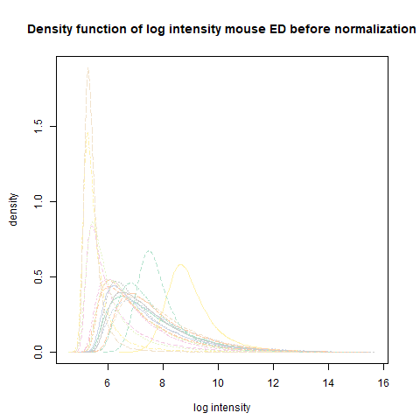
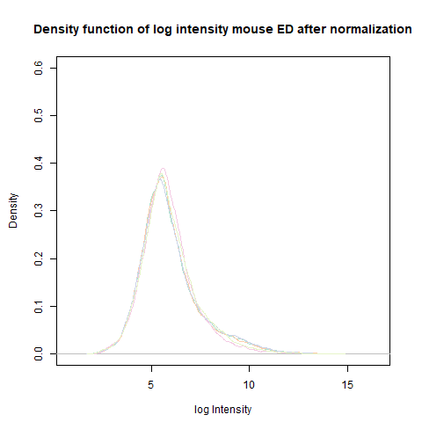
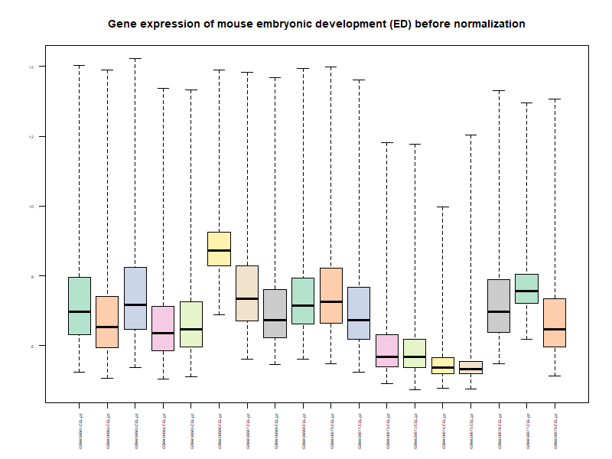
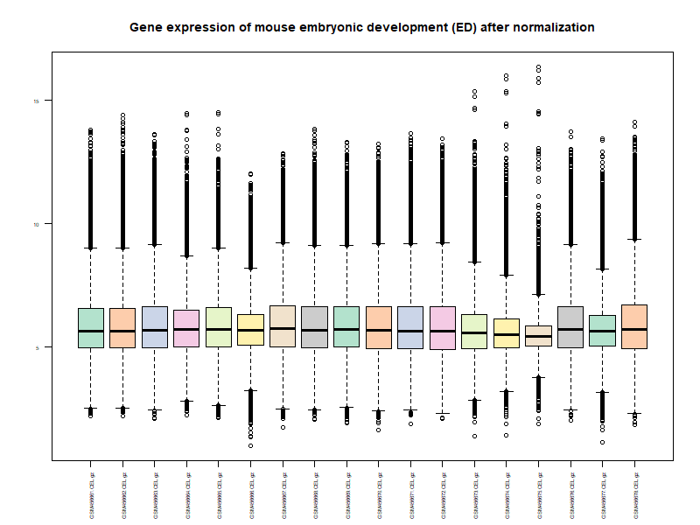

Slide 7
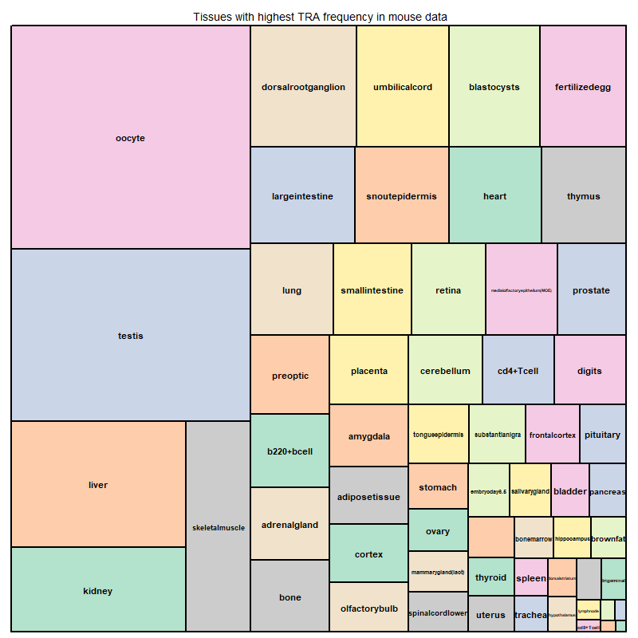
TRAs in our mouse dataset
6188 TRA transcripts
3255 TRA genes

Slide 8
Largest changes in the gene expression of TRAs is found between the fourth and eighth cell stages
→Differential Gene Expression

Slide 9
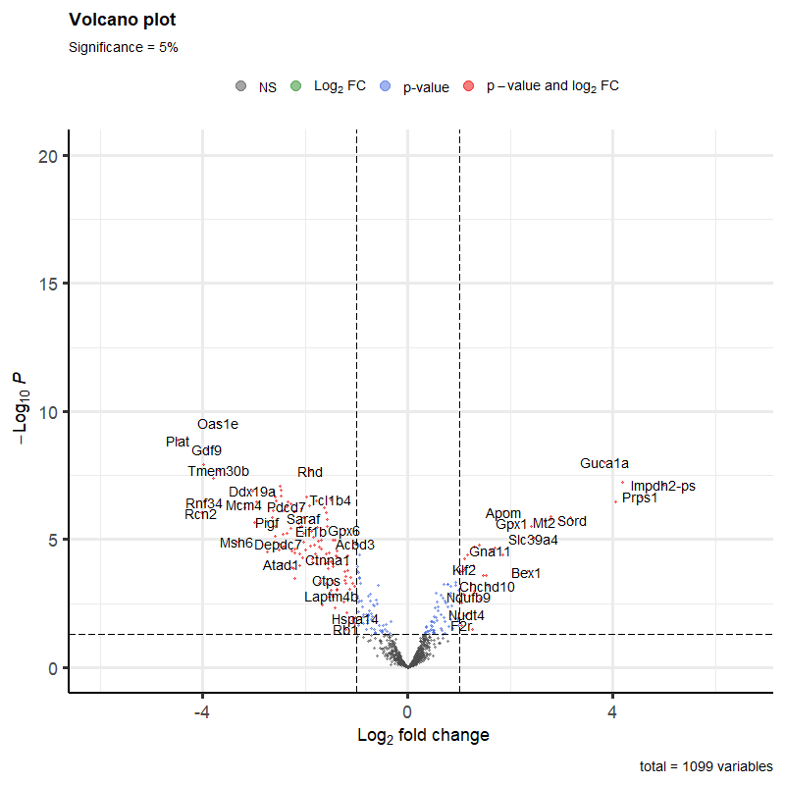
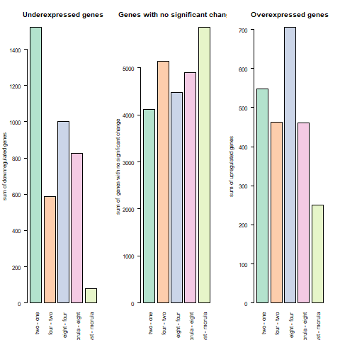
Mouse DGE results: volcano and bar plots

Slide 10
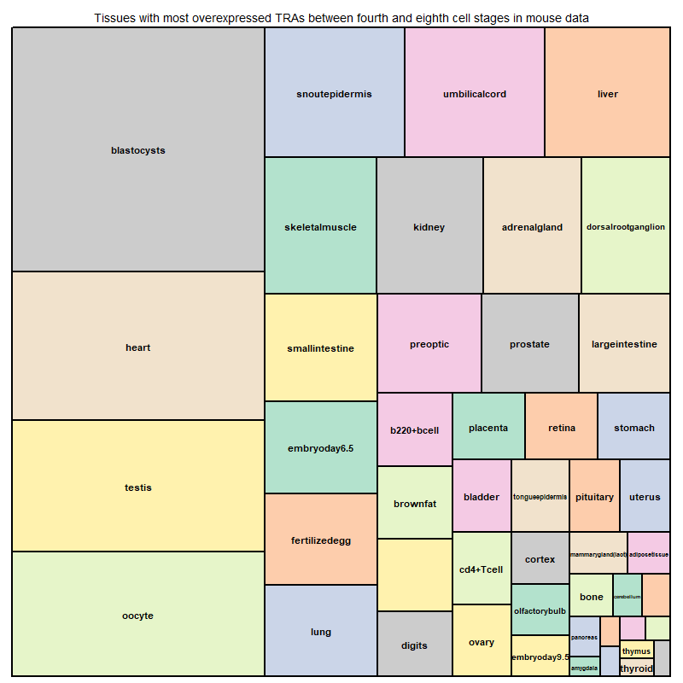
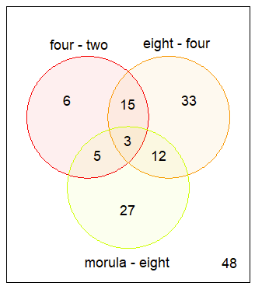
Distribution in tissues
Overexpression in 4-8 cell stages
Highest amount of TRAs in oocyte
2nd highest in heart -> first organ to develop

Slide 11
Heart
Three transcripts in common -> gene: Idh2
Isocitrate dehydrogenase (enzyme in mitochondria)
Key features of development in mouse
Cardiac progenitor cells arise from mesoderm
Fuse into linear heart tube
Heart tube grows by division of myocardial cells

Slide 12
What is an important biological function expressed by those genes?
Gene Set Enrichment Analysis

Slide 13
GSEA: HALLMARK HYPOXIA
Hypoxia
Important in low oxygen conditions -> hypoxia inducible factors (HIF) activated
HIF regulates morphogenesis of the developing heart
Activates large group of genes
Promote anaerobic metabolism to reduce oxygen consumption
Mammalian embryo develops in low oxygen conditions
HIF absolutely required for development of heart

Slide 14
Is the gene expression in bovine comparable to the expression in mouse?
DGE and GSEA for bovine data set

Slide 15
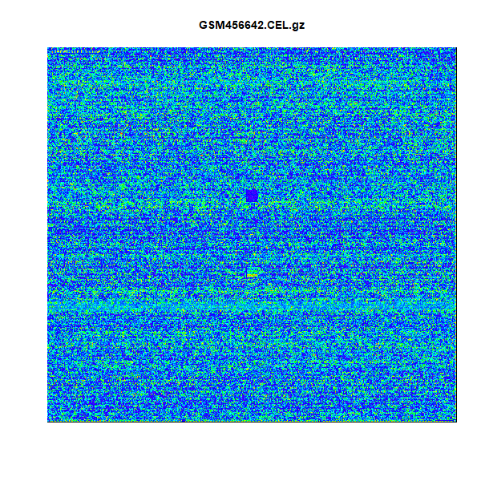
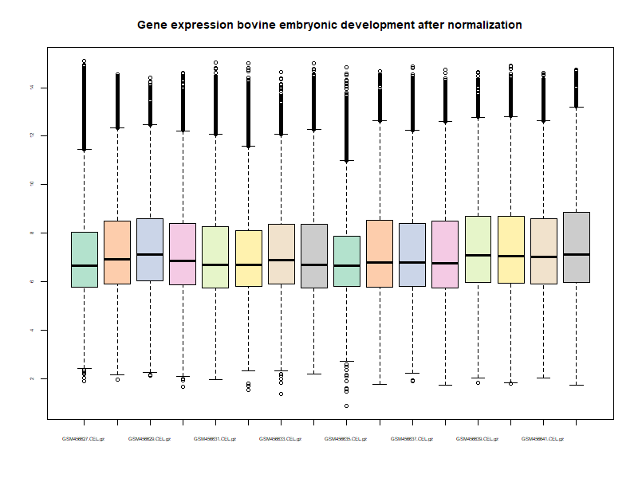
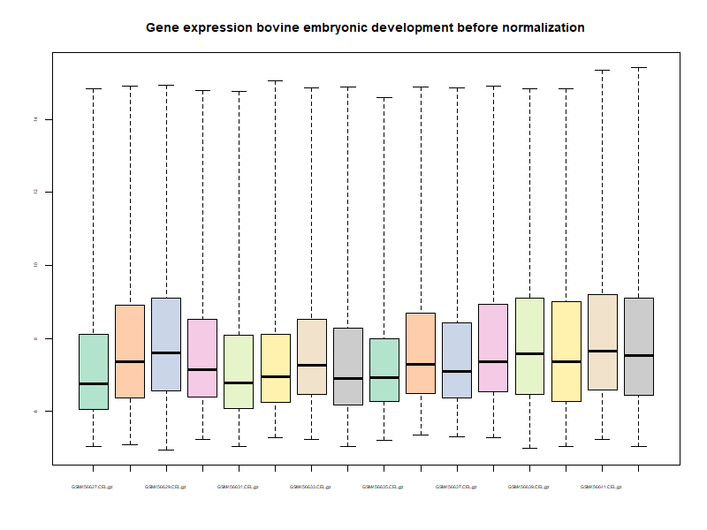
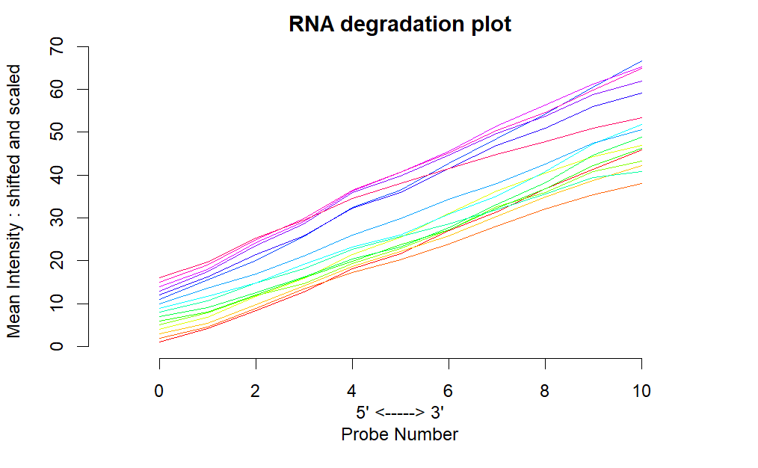
Bovine quality control and vsn

Slide 16
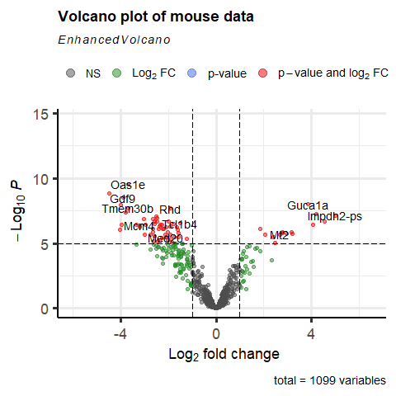
DGE bovine
Less as significantly deregulated genes as mouse

Slide 17
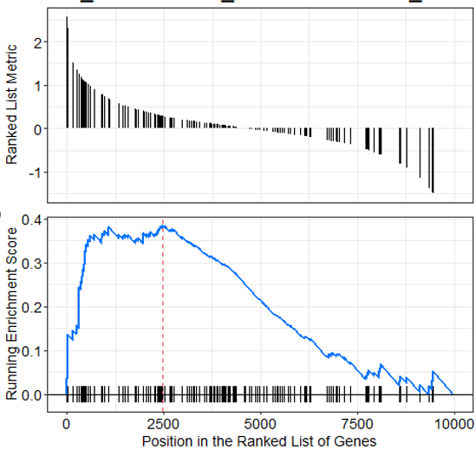
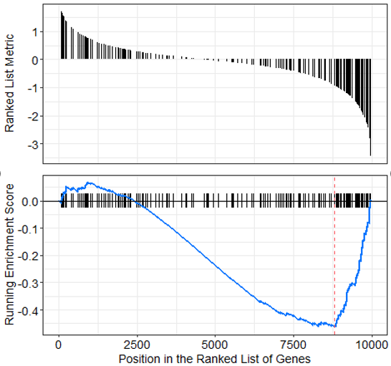
GSEA bovine
Hallmark epithelial mesenchymal transition
upregulated
Hallmark oxidative phosphorylation
downregulated

Slide 18
Link between hypoxia and oxdative phosphorylation
Oxidative phosphorylation is the primary metabolic pathway for ATP production (in mitochondria)
In hypoxic conditions → insufficient oxygen levels → insufficient ATP levels and high amounts of ROS
Can result in necrotic/ apoptic cell death → can lead to heart failure
In hypoxic state downregulation of oxidative phosphorylation is needed

Slide 19
Conclusion
TRA expression between fourth and eighth cell stages is significantly deregulated
TRA expression between fourth and eighth cell stages is linked to heart formation during embryonic development
Hypoxia Hallmark and oxidative phosphorylation hallmark are comparable in regard to heart formation

Slide 20

Thank you for your attention!
Notes:
Conclusion:

Slide 21
The Role of TRAs in Early Embryonic Development
Final project presentation
Group 4: Amena Elmaadawy, Mariam Hassan, Nina Droste, Aleksandra Dohren
Supervisors: Dr. Maria Dinkelacker, Ian Fichtner
Molecular Biotechnology B. Sc, Ruprecht Karls University of Heidelberg

Slide 22

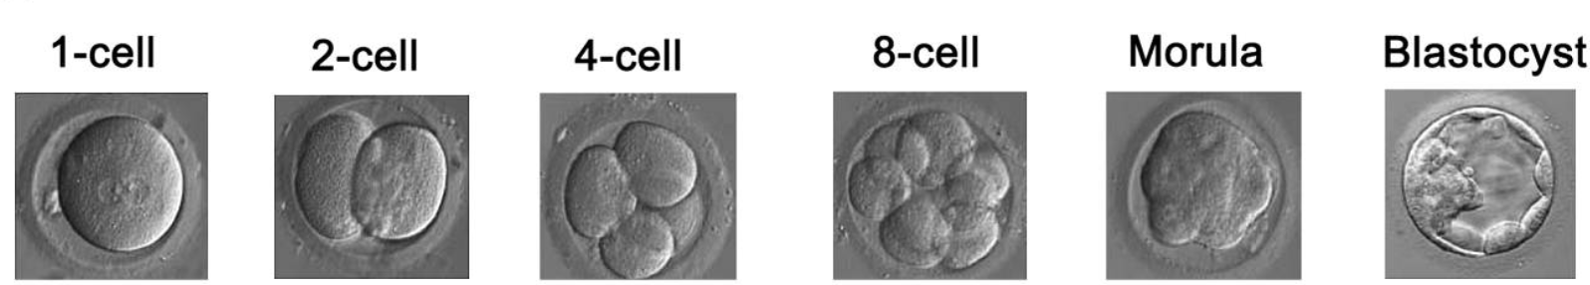
Preimplantation embryo development
Global transcriptional profiles of mammalian PED
We use preimplantation mouse data
cDNA collected on Affymetrix Gene Chips
Xie et al. 2010
Xie et al. 2010 ; Geisert, Spencer 2021

Slide 23

Introduction to TRAs
Tissue restricted antigens
Highly expressed by mTECs
Regulated by AIRE and Fezf2
establishment of central-self tolerance (negative selection)
Dinkelacker (2019); Takaba and Takanayagi (2017)

Slide 24
TRAs in specific context
TRA- Database by Dinkelacker 2007/2019
Highly and specifically expressed in certain tissues
" tissue-restricted if it exceeds 5x the median gene expression in at least one and not more than five tissues out of all tissues in the dataset"
Tissue-specificity is important for development of the three germ layers

Slide 25

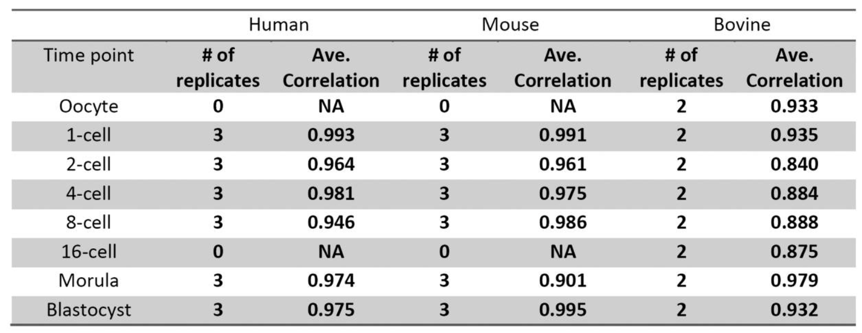
Our dataset
GSE18290; Xie et al. 2010 Affymetrix MOE430A
Xie et al. (2010) Rewirable gene regulatory networks in the preimplantation development of three mammalian species

Slide 26

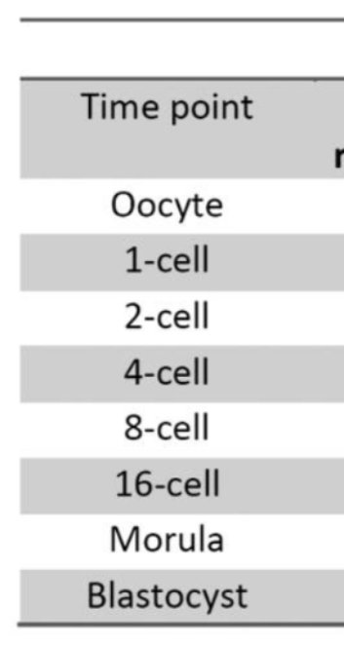
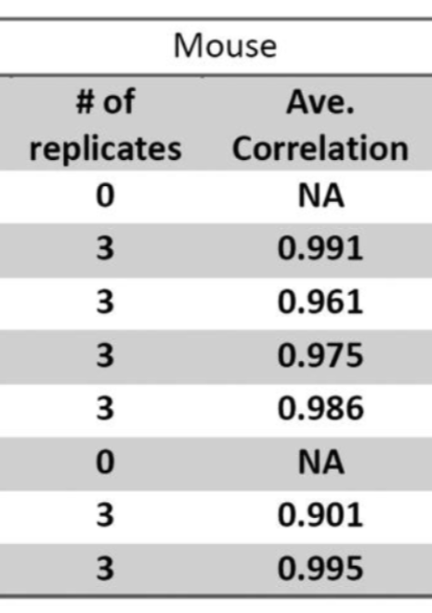
Our dataset
Rewiring of regulatory networks in PED PED
Largest changes of expression between four- and eight-cell stages
Xie et al. 2010
Xie et al. (2010) Rewirable gene regulatory networks in the preimplantation development of three mammalian species

Slide 27
Large changes in gene expression between four- and eight-cell stages are linked to the expression of TRAs and thus to tissue development
Notes:
True, 4-8 cell stage ist overregulated: DGE, unsignifikant unsignifikant sagt niht, dass es keine changes gibt.
Tissue development: Wir haben getestet GSEA 4/8/ all show HYPOXIA Pathways, and no tissue development pathways
There larges change in gene exressioen do not indicate tissue development. Therefore TRA expression is not mecessarly liked to tissue development

Slide 28
Sub questions
Is the greatest TRA expression found between the fourth and eighth cell stage?
Is TRA expression in bovine comparable to TRA expression in mouse?
Which is the earliest biological function expressed by those genes?
Notes:
Yes, we found that with DGE -> Graphen tabellen etc.
We dont have bovine TRA data sets to match but we compared pathways that are significant in either bovine or mouse and we didnt find matching ones. With given tra table bovine we are able to identify TRA Genes that are behaving similarly in both, mouse and bovine. More time and resou
We found pathways -> Hypoxia

Slide 29

Milestones
Choose data set
Quality control
Statistical tests, TRA determination in our data set
Code clean-up, markdown preparation, and finishing touches
1st week of May
1st- 2nd week of May
1st- 2nd week of June
3rd- 4th week of June
1st- 2nd week of May
3rd week of May
2nd- 3rd week of June
3rd week of July
Normalization of microarray data
Descriptive analysis
TRA determination, gene clustering
Prepare final presentation

Slide 30

What have we achived so far
Choose data set
Quality control
Statistical tests, TRA determination in our data set
Code clean-up, markdown preparation, and finishing touches
1st week of May
1st- 2nd week of May
1st- 2nd week of June
3rd- 4th week of June
1st- 2nd week of May
3rd week of May
2nd- 3rd week of June
3rd week of July
Normalization of microarray data
Descriptive analysis
TRA determination, gene clustering
Prepare final presentation

Slide 31
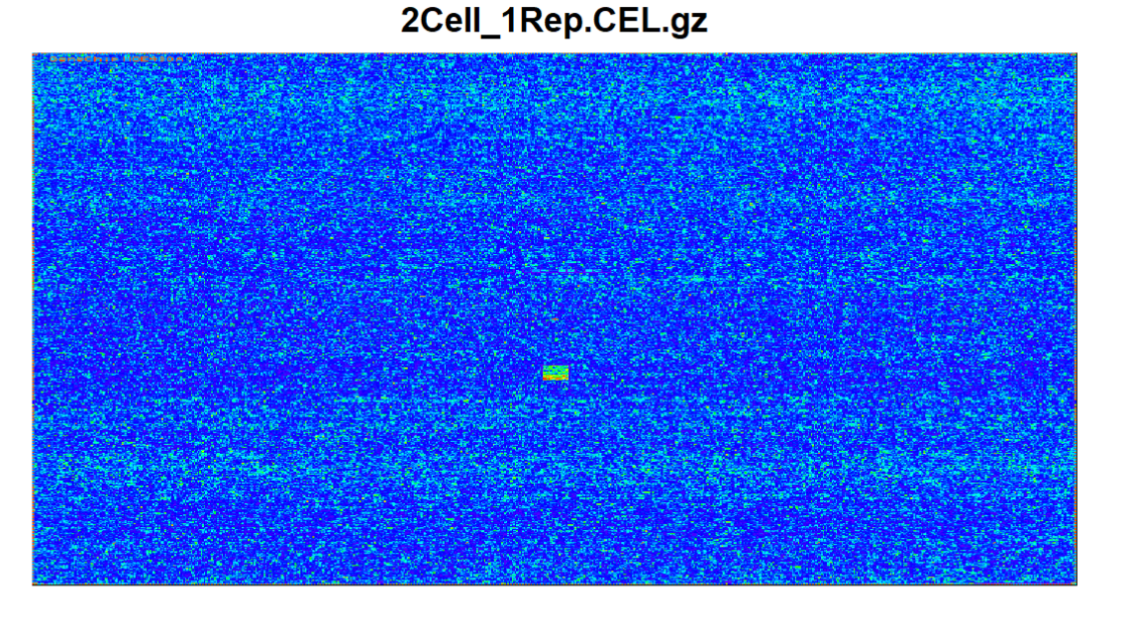
Quality control of chips: Single chip control

Slide 32
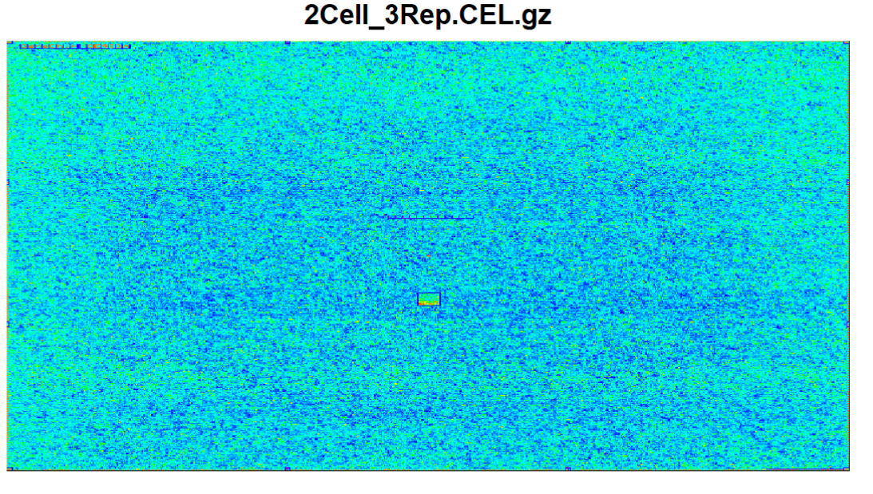
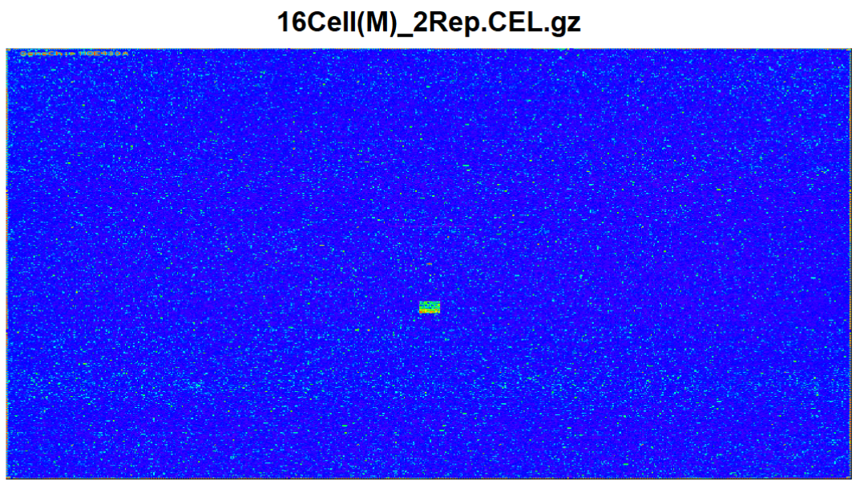
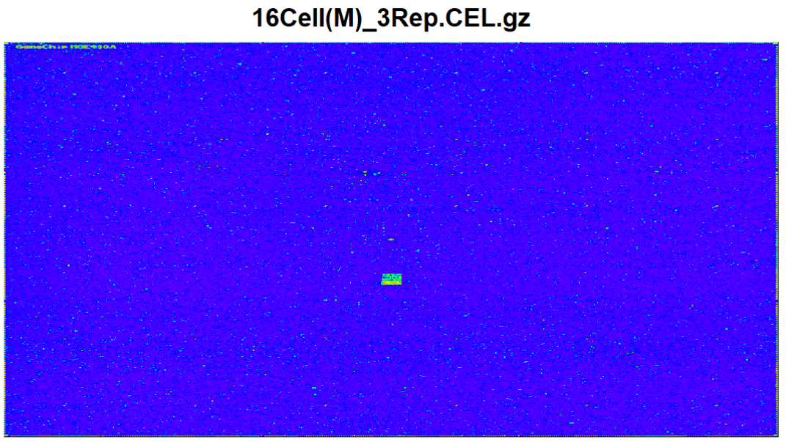
Excluded chips
Exclusion of over- and underexpressed chips

Slide 33
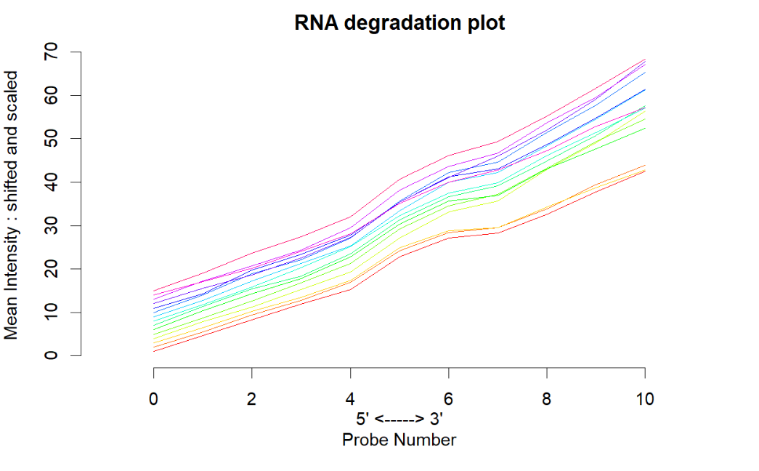
Quality control: RNA degradation

Slide 34
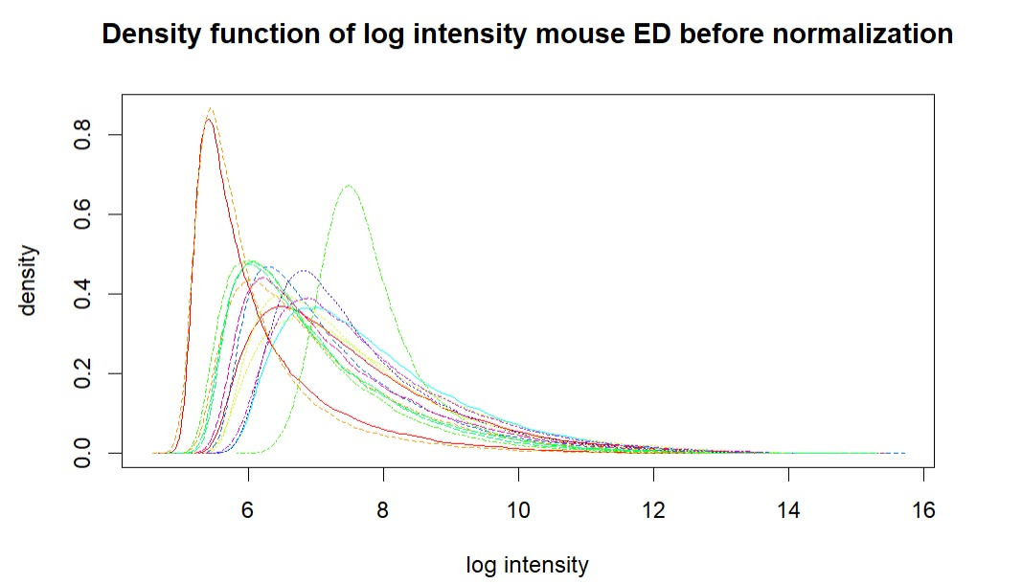
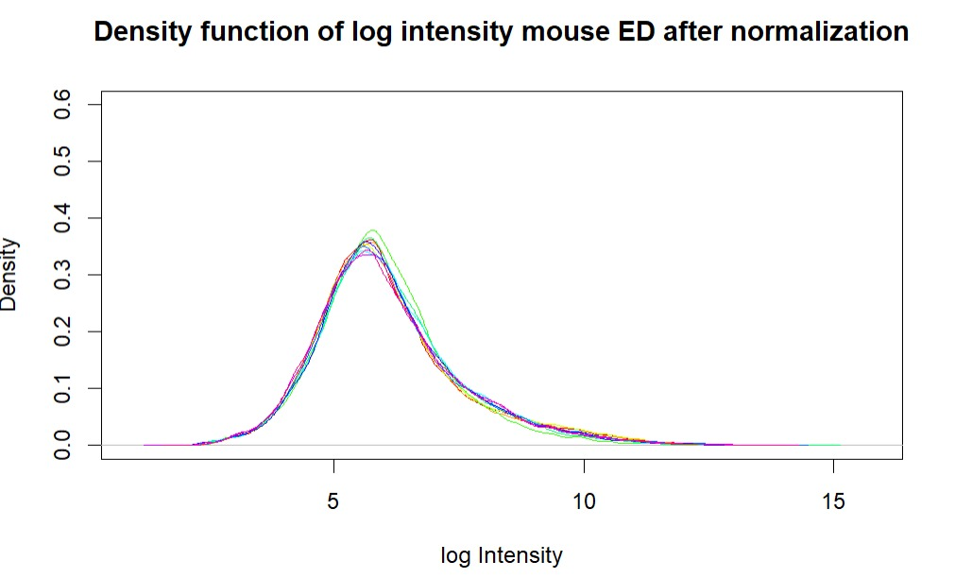
Quality control: Density plots

Slide 35
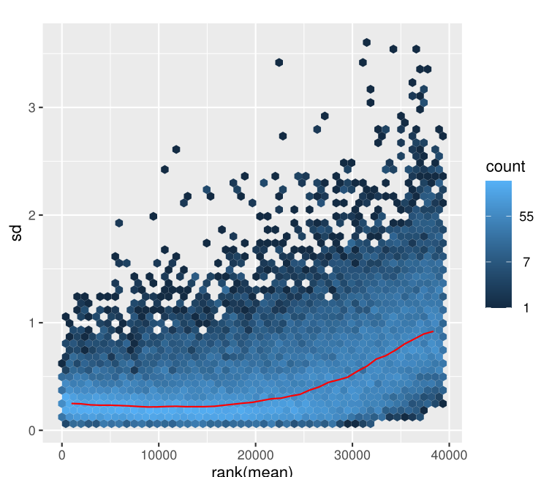
Quality control: meanSd-plot
standard deviation
rank(mean)

Slide 36
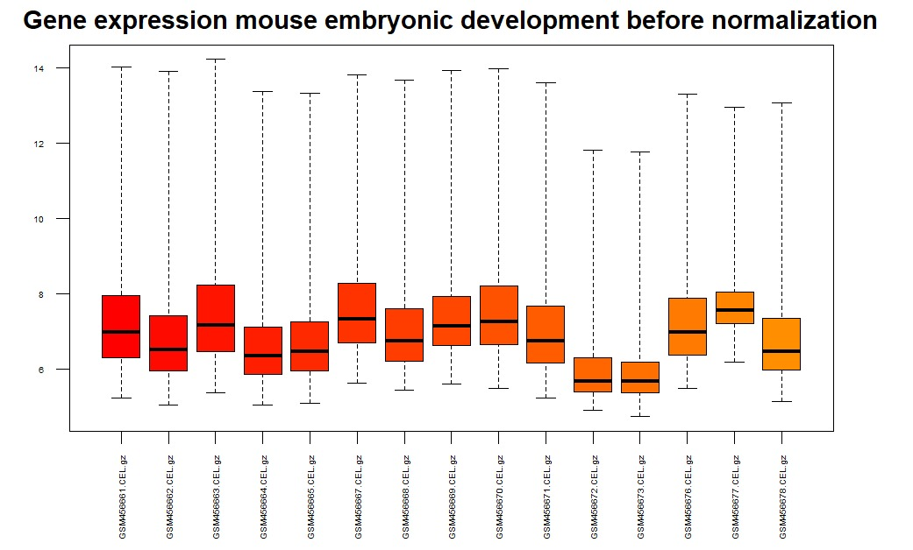
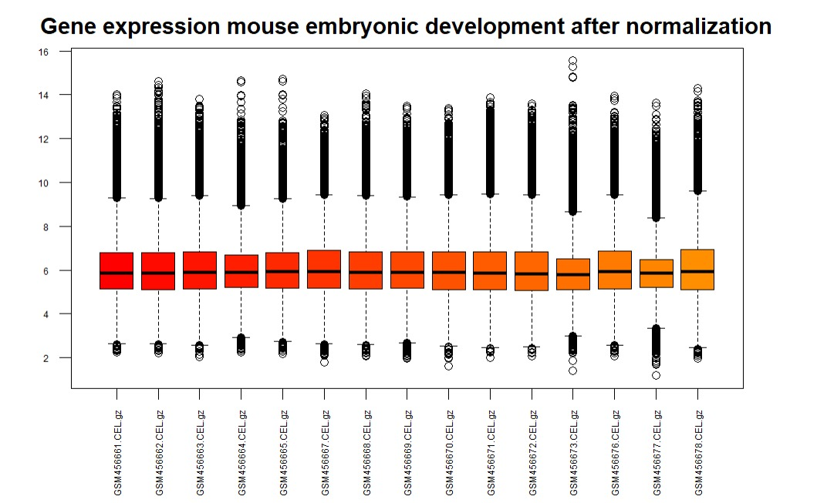
Quality control: Boxplot
Gene expression mouse embryonic development before normalization
Gene expression mouse embryonic development after normalization

Slide 37
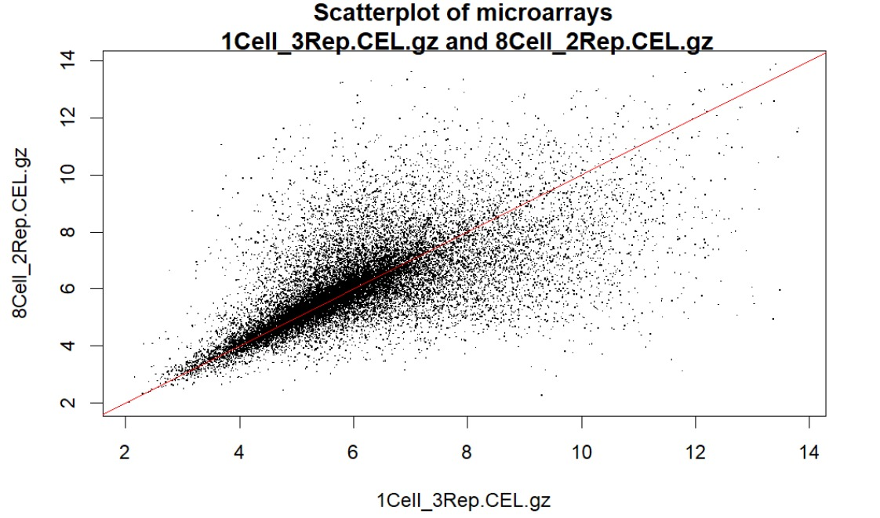
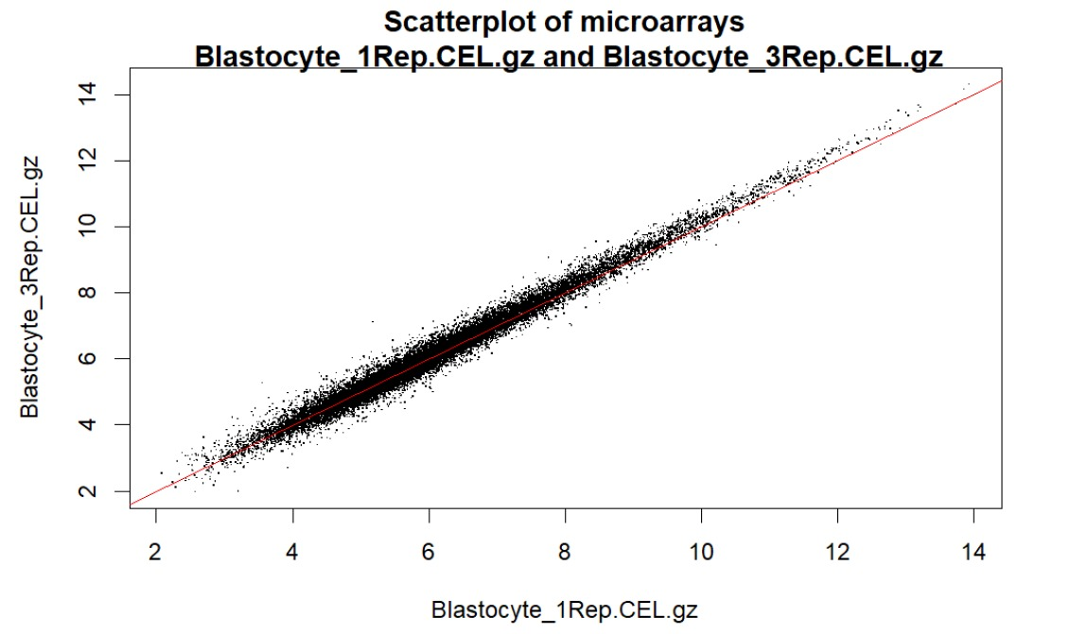
Quality control: Scatter plot

Slide 38
Conclusion

Slide 39
Thank you for your attention!
Notes:
Conclusion:

